Slide 1
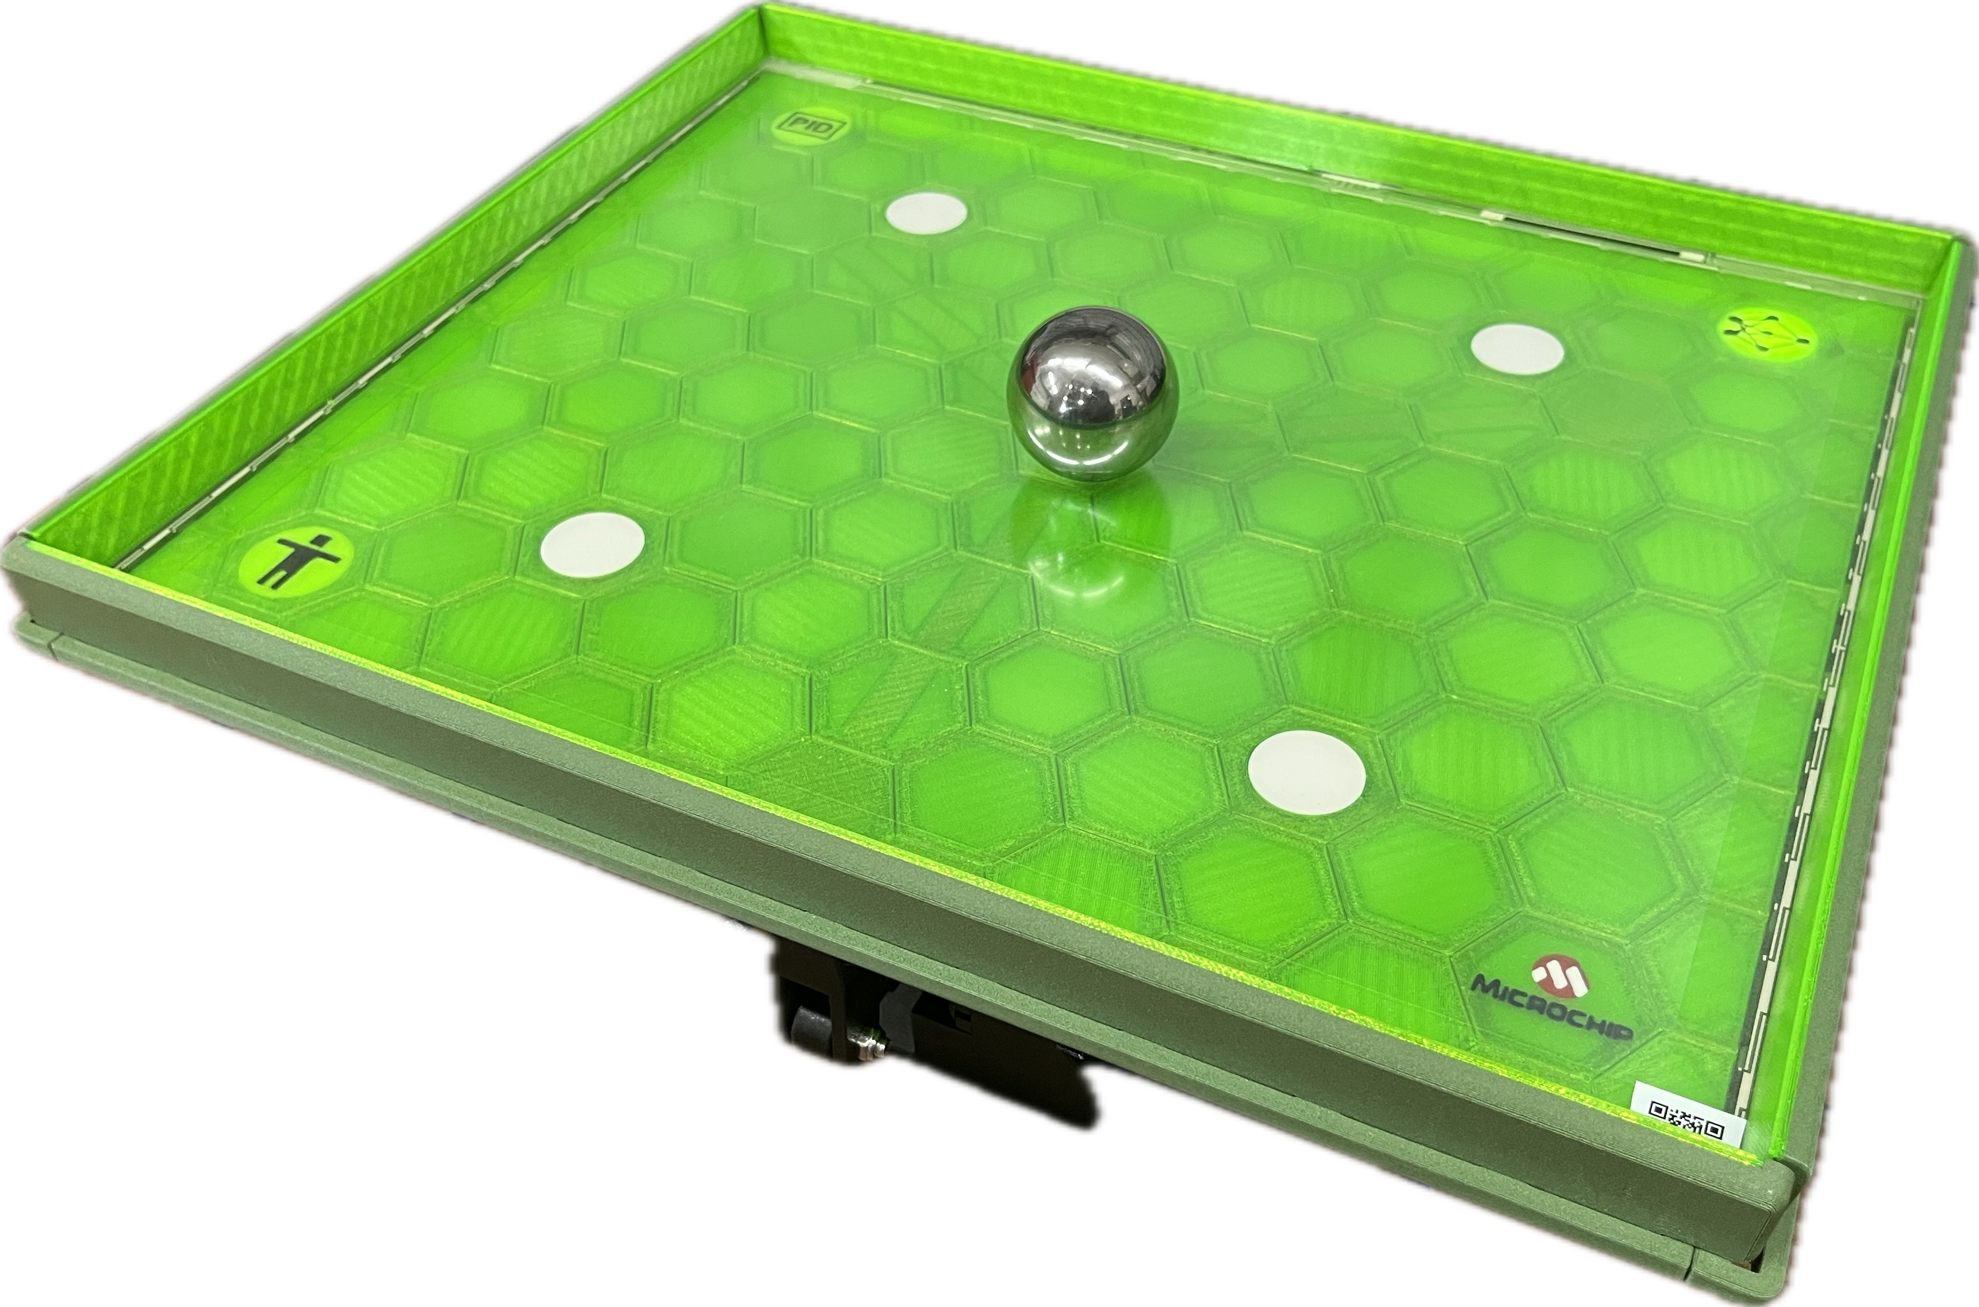

Machine Learning Ball Balancer
https://github.com/gmrozek-mchp/mlbb

Slide 2
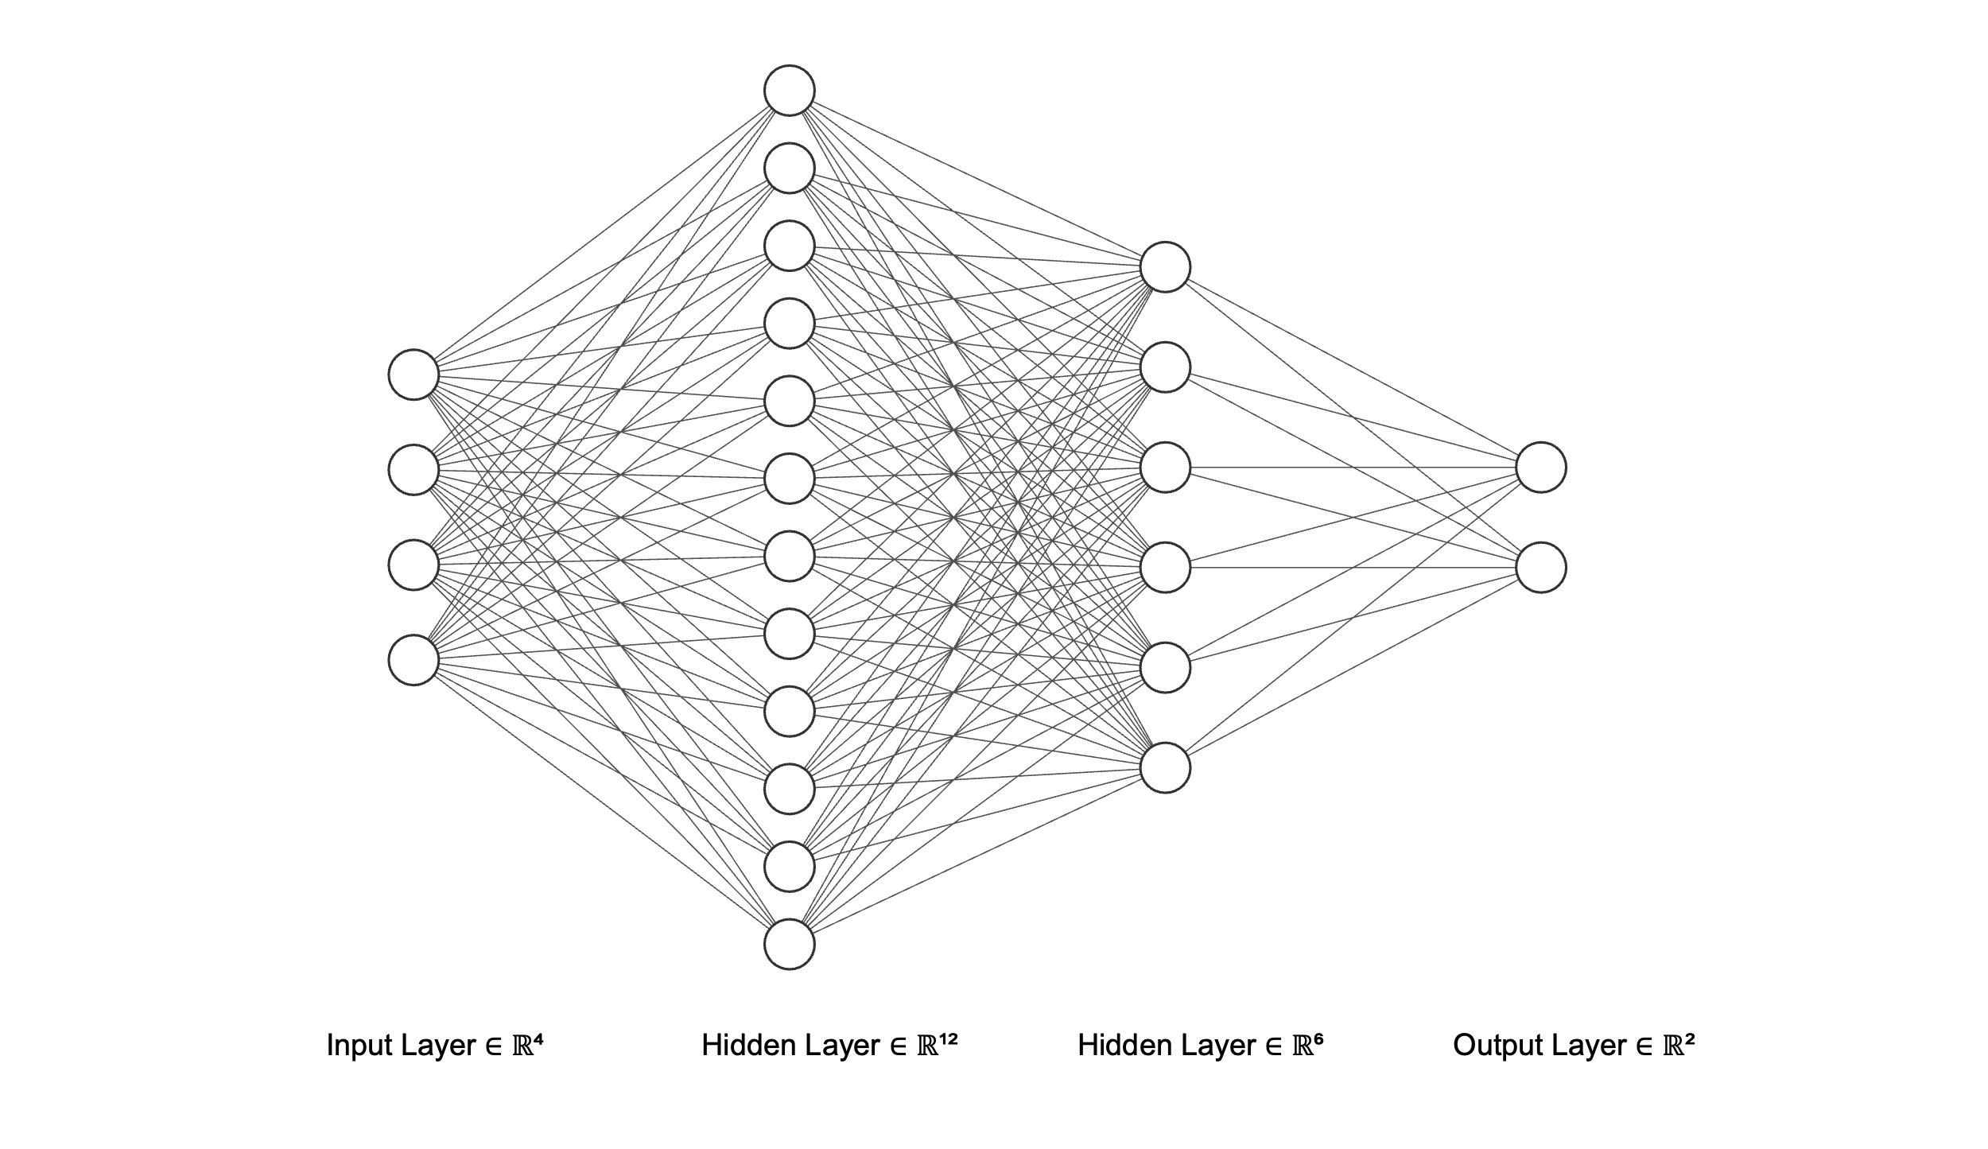
Machine Learning Ball Balancer
FULLY CONNECTED (DENSE) NEURAL NETWORK
error_x
velocity_x
platform_x
error_y
platform_y
velocity_y
Linear Activation
ReLU Activation
ReLU Activation
Linear Activation

Slide 3
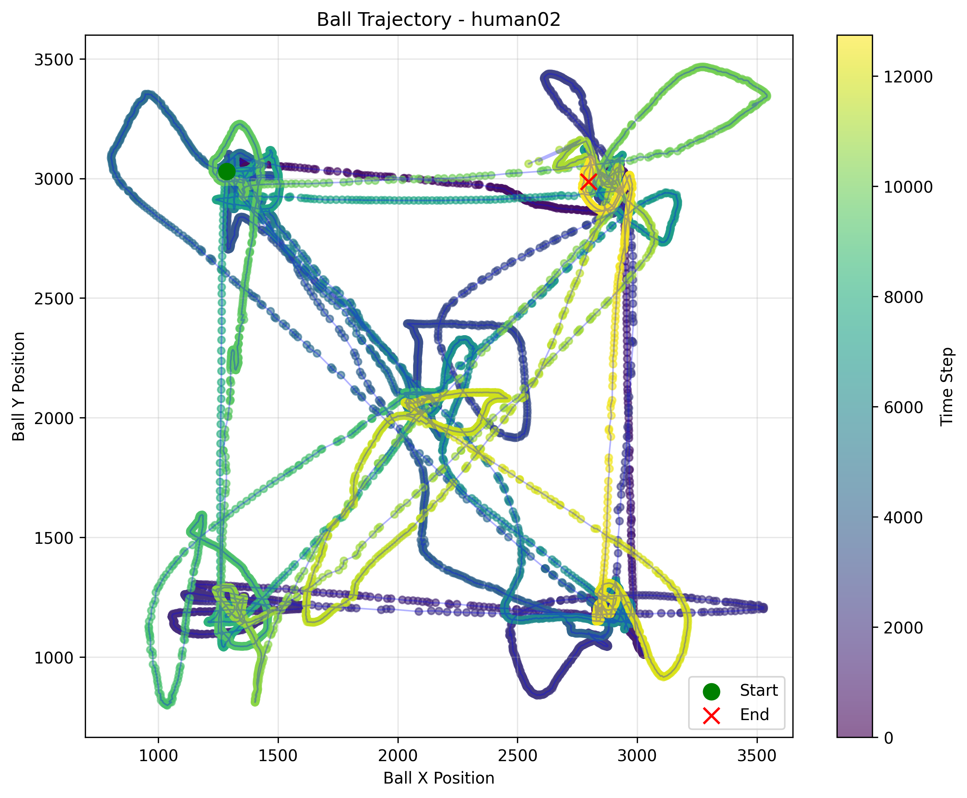
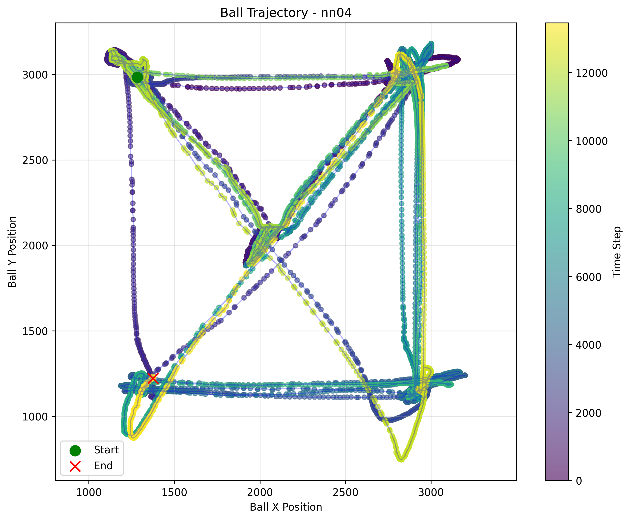
Machine Learning Ball Balancer
Human Generated Training Data
TRAINING
HUMAN CONTROL
NN CONTROL

Slide 4
Machine Learning Ball Balancer
Bonus Content - “Vibe coding” a Fuzzy Logic Balancer
**User** - implement a new balance module based on fuzzy logic control
**Claude** - … Now I'll create a fuzzy logic-based balance module. I'll implement a Mamdani-style fuzzy logic controller with triangular membership functions for the input and output variables.
100% coded, tuned and documented by chat with Claude AI
ZERO human code entry / edits
## 1. Membership Functions
### Error Membership Functions (Triangular)
```
Membership Degree
1.0 | NL NS ZE PS PL
| /\ /\ /\ /\ /\
| / \ / \ / \ / \ / \
| / \ / \ / \ / \ / \
| / \/ \/ \/ \/ \
0.0 |-----------------------------------------------
-8192 -4096 -2048 0 2048 4096 8192
Error Value (Q15)
The fuzzy logic balance module (`balance_fuzzy.c` and `balance_fuzzy.h`) implements a Mamdani-style fuzzy logic controller for the ball balancing system. This module provides an alternative to the PID controller with potentially better handling of non-linear dynamics and uncertainty. - Claude
**Linguistic Variables:**
- **NL (Negative Large)**: [-8192, -4096, 0]
- **NS (Negative Small)**: [-3584, -2048, -512]
- **ZE (Zero)**: [-1024, 0, 1024]
- **PS (Positive Small)**: [512, 2048, 3584]
- **PL (Positive Large)**: [0, 4096, 8192]

